Slide 1
TECH PHANTOMS
HACKAHTON
Theme : WEB DEVELOPMENT

Slide 2



TUNE-IN
Play your favorites
Listen to the songs you love.
You can browse popular playlists
DISCOVER NEW MUSIC AND PODCASTS
PODCASTS ARE JUST PLENTIFUL,
SO WHETHER YOU LOVE LISTENING TO
TRUE CRIME STORIES
Or
TO TECH DISCUSSIONS
There is something for everyone !!!

Slide 3
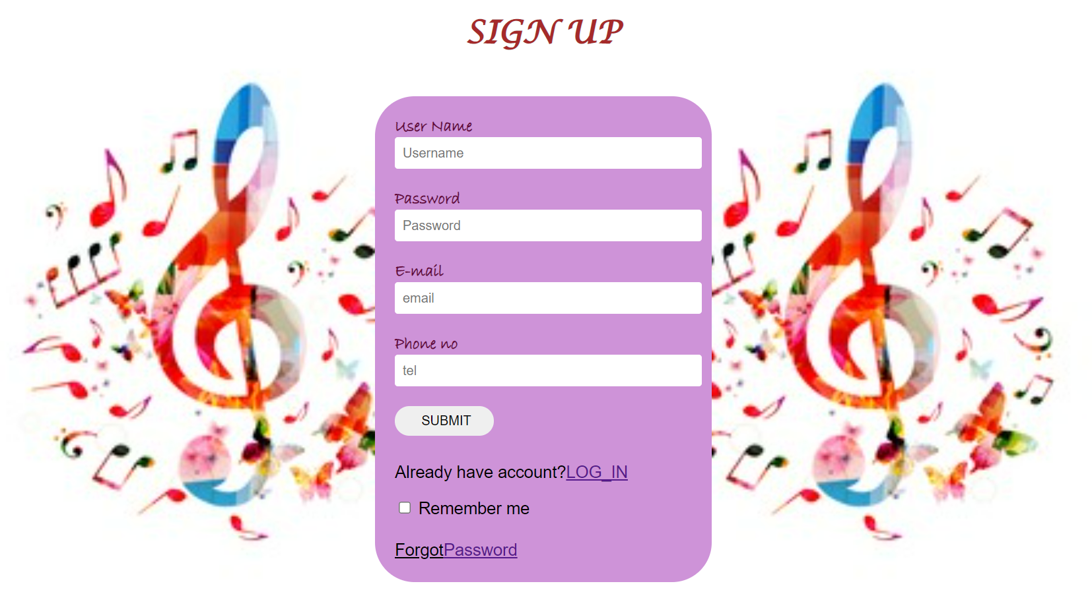
Sign up by filling
the details.
And click on submit.
We also have option to remember your password and
mail-id ,this can be
done by clicking
on the check box below
If already signed up ,then we have an option to log-in, this will take you to the login page

Slide 4

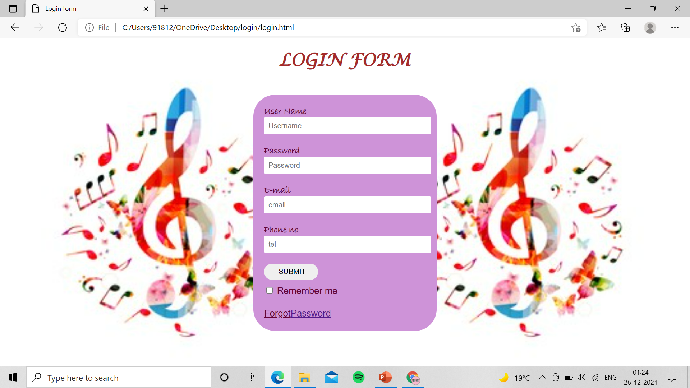

Slide 5

THANK YOU
☺
P.VASAVI
V.SREE KOUMUDI
SRAVANI
SWETHA

